Slide 2
Question 5

Slide 3
Question 5 theory
Two-way analysis of variance is based on the further
assumption that the cell population means have an additive
structure:
μ_{ij} = μ + α_{i} + β_{j} .
Here μ is the overall mean, the row effects αi, and the
column effects βj.

Slide 4
Question 5a
Factors
Titration methods (columns)
Solutions (row)
Levels and controllability
Titration Methods: A,B,C Controllable
Solution: 1,2,3,4 Not Controllable

Slide 5
Question 5a
The factor of primary interest is the titration method.
The nuisance factor is the solutions.

Slide 6
Question 5b(ii)
What would have to be done in order to study the
interactions?
ANS: Obtaining replicate measurements for each
combination of levels would be needed

Slide 7
Question 5b(iii)
Will interactions play a role in this study?
The solutions are levels of an uncontrollable nuisance factors.
The interactions are not of particular interest because they are hard to interpret.

Slide 8
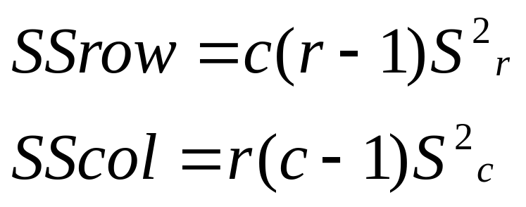
Question 5c
Sums of Squares

Slide 9
Question 5c
Sums of Squares
Given
SSTot = 0.0513 df = rc-1 = 11
SSRow = 0.0111 df = c-1 = 2
SSCol = 0.0120 df = r-1 = 3
SSTot = SSRow + SSCol + SSRes
SSRes is therefore 0.0282
df(res) = (r-1)(c-1) = 6

Slide 10
Question 5c
ANOVA
Sources | SS | df | MS | F stat | F crit
Rows | SSrow | r-1 | MSrow | Frow | (given)
Columns | SScol | c-1 | MScol | Fcol | (given)
Residuals | SSres | (r-1)(c-1) | MSres
Total | SStot | rc-1

Slide 11
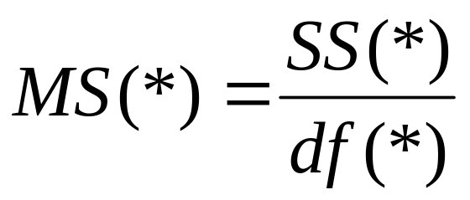
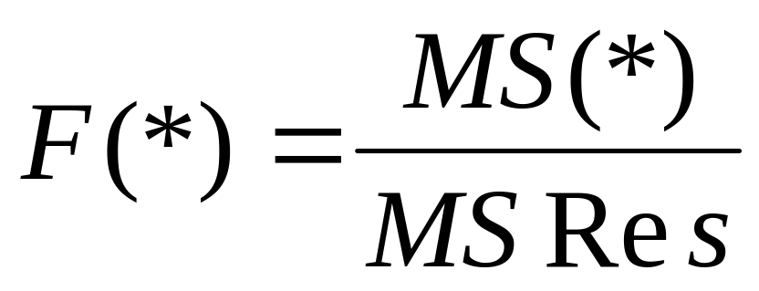
Question 5c
MS terms
Test Statistics

Slide 12
Question 5c
ANOVA
Sources | SS | df | MS | F stat | F crit
Solutions | 0.0111 | 3 | 0.0037 | 0.7871 | 4.7571
Titrations | 0.0120 | 2 | 0.0060 | 1.2791 | 5.1433
Residual | 0.0282 | 6 | 0.0047
Total | 0.0513 | 11

Slide 13
Question 5d
The purpose of the first F test is to determine if there is any significant differences in the titration methods
Null Hypothesis H₀ : α _{i} = 0 for all i,
Alt. Hypothesis H_{a} : α_{i} ≠ 0 for all i,
(α _{i} - row effects)
F.crit is given. We need to determine the test statistic F₁
Reject the null if F₁ is greater than F.crit.

Slide 14
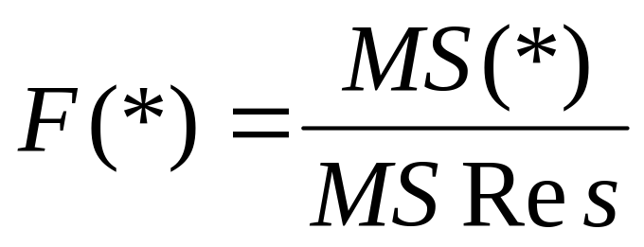
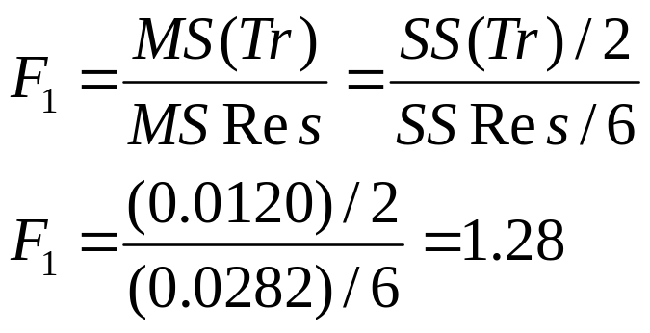
Question 5d
Test statistic F₁

Slide 15
Question 5d
The critical value is 5.143
It is from the F distribution with (2,6)degree freedom
[r-1],[(r-1)(c-1)]
The test statistic (1.28) is not greater than the critical value, so we fail to reject the null.
There is no significant difference between the columns
(i.e. the titration methods)

Slide 16
Question 5e
The purpose of the second F test is to determine if there is any significant differences in the concentrations of chloride
Null Hypothesis H₀ : β_{i} = 0 for all i,
Alt. Hypothesis H_{a} : β_{i} ≠ 0 for all i,
(β_{i} - column effects)
F.crit is given. We need to determine the test statistic F₂
Reject the null if F₂ is greater than F.crit.

Slide 17
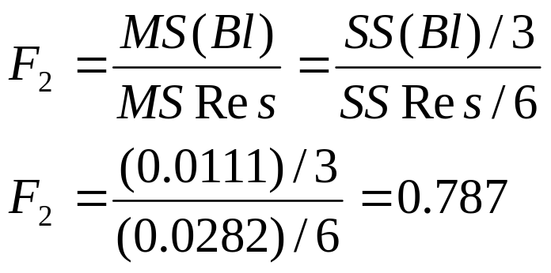
Question 5e
Test statistic F₂

Slide 18
Question 5e
The critical value is 4.757
It is from the F distribution with (3,6)degree freedom
[c-1],[(r-1)(c-1)]
The test statistic (0.787) is not greater than the critical value, so we fail to reject the null.
There is no significant difference between the columns
(i.e. the titration methods)

Slide 19
Q5 Two factor ANOVA
First Null Hypothesis of interest is that all the
row effects α_{i}, i = 1, . . . , r are zero.
If that is true the row classification is
redundant.
H₀ : α_{i} = 0 for all i,

Slide 20
Question 5f Regression Anova
ANOVA Table
 | Df | Sum Sq | Mean Sq | F value | Pr(>F)
Sol | A | 0.011092 | C | 0.7871 | 0.5435
Meth | 2 | 0.012017 | 0.006008 | D | 0.3446
Residuals | 6 | B | 0.004697

Slide 21
Question 5f Regression Anova
A
ans = 3 degrees of freedom n-1
B
From before, the residual SS is 0.0282

Slide 22

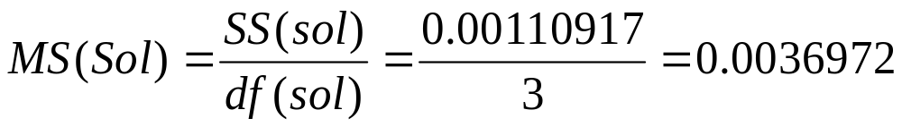
Question 5f Regression Anova
C
In general
Therefore

Slide 23
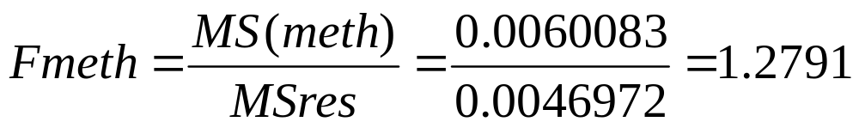
Question 5b Regression Anova
D

Slide 24
Question 5b Regression Anova
ANOVA Table
 | Df | Sum Sq | Mean Sq | F value | Pr(>F)
Sol | 3 | 0.011092 | 0.003697 | 0.7871 | 0.5435
Meth | 2 | 0.012017 | 0.006008 | 1.2791 | 0.3446
Residuals | 6 | 0.028183 | 0.004697

